Slide 1
.Net Framework Overview
Introduction to .Net framework
September 9, 2016

Slide 2
Agenda
.Net Framework
Assemblies

Slide 3
The .Net Framework

Slide 4
What is Net Framework?
.Net Framework
An environment for developing and executing .Net applications
Unified programming model, set of languages, class libraries, infrastructure, components, tools for application development
Environment for controlled execution of managed code
It is commonly assumed as
.Net platform = .Net Framework
Common Language Runtime (CLR)
Environment for controlled execution of programed code – like a virtual machine
Executes .Net applications

Slide 5
What is Net Framework?
Framework Class Libraries (FCL)
Standard class library for .Net development
Delivers basic functionality for developing : XML, ADO.Net, LINQ, ASP.Net, WPF, WCF, Silverlight, Web Services, Windows Forms etc..
SDK, compilers, tools

Slide 6
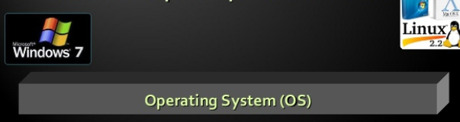
.Net Framework Architecture
The OS manages the resources, the processes and user machine
Provides to the application some services (threads, I/O, GDI+, COM, COM+, MSMQ, IIS…)
CLR is separate process in OS

Slide 7
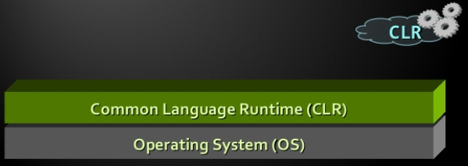
.Net Framework Architecture
CLR manages the execution of .NET code
Manages the memory, concurrency, security..

Slide 8
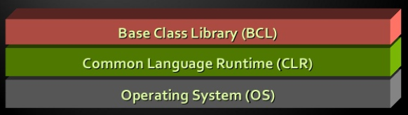
.Net Framework Architecture
Rich Object Oriented Library with fundamental classes
Input-output, collections, text processing, networking, security, multi-threading

Slide 9
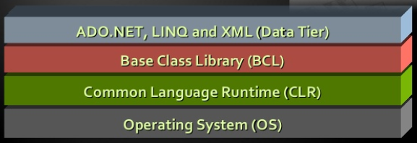
.Net Framework Architecture
Database Access
ADO.Net,LINQ, LINQ-to-SQL, Entity Framework
Strong XML support

Slide 10
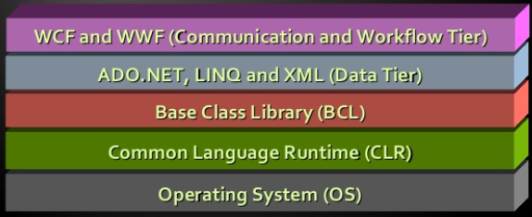
.Net Framework Architecture
Windows Communication Foundation (WCF) and Windows Workflow Foundation (WWF) for SOA world

Slide 11
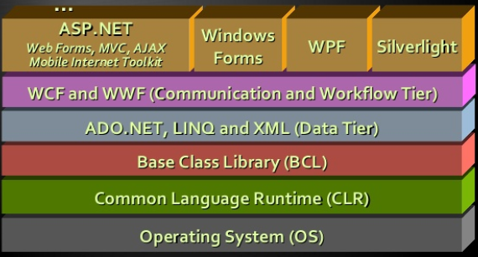
.Net Framework Architecture
User Interface technologies: Web based, Windows GUI, WPF, Silverlight, Mobile

Slide 12
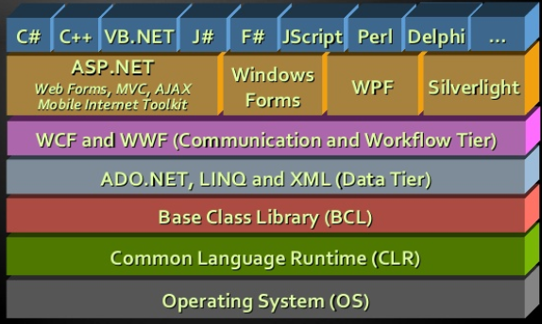
.Net Framework Architecture
Programming Language on your flavor

Slide 13
Common Language Runtime (CLR)

Slide 14
Common Language Runtime (CLR)
Managed Execution environment
Controls execution of managed .Net programming code
Something like Virtual Machine
Like Java Virtual Machine
Not an Interpreter
Compilation on-demand is used
Known as Just-In-Time (JIT) compilation
Possible compilation in advance (ngen.exe)

Slide 15
Responsibilities of CLR
Execution of IL code and the JIT compilation
Managing memory and application resources
Ensuring Type Safety
Interaction with the OS
Managing Security
Code Access Security
Role Based Security
Managing Exceptions
Managing Concurrency – controlling the parallel execution of application threads

Slide 16
Responsibilities of CLR (continued..)
Managing application domains and their isolations
Interaction with Unmanaged code
Supporting debug /profile of .Net code

Slide 17
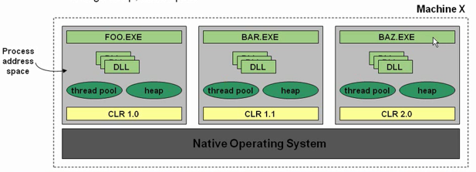
The Common Language Runtime
The CLR is implemented as a set of in-process DLLs
Loaded only into processes that run managed code
Different apps can load different version of CLR
Each process has its own run-time resource E.g. head, thread-pool

Slide 18
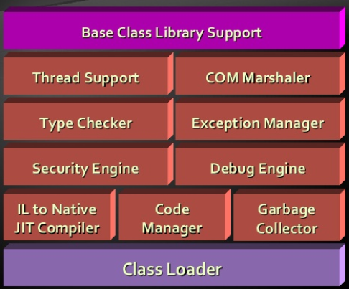
CLR Architecture

Slide 19
Common Type System (CTS)

Slide 20
Common Type System (CTS)
CTS defines the CLR supported types of data and the operations over them
Ensures data level compatibility between different .Net languges. E.g. String in C# is same like in VB.NET and J#
Value types and reference types
All types derive form System.Object

Slide 21
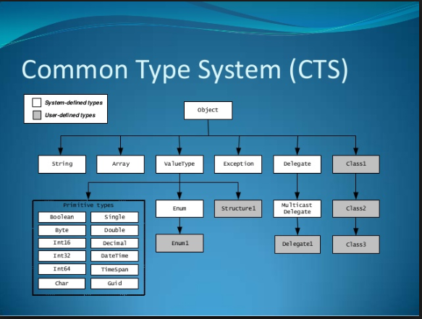
Common Type System (CTS)

Slide 22
Framework Class Libraries (FCL)

Slide 23
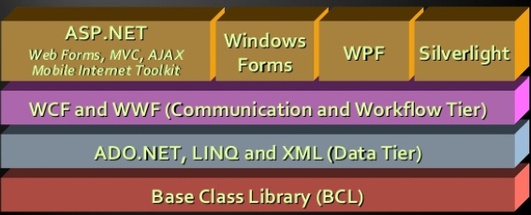
Framework Class Library
Framework Class Library is a standard .Net Framework library of out-of-box reusable classes and components (API)

Slide 24
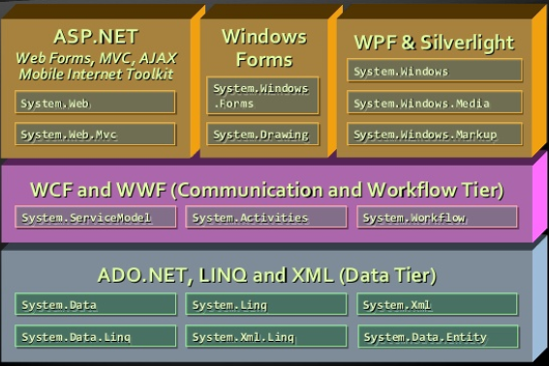
FCL Namespaces

Slide 25
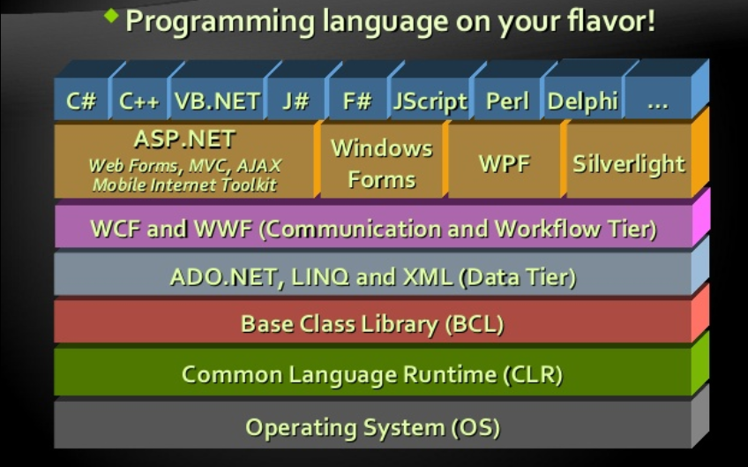

Slide 26
Managed and UnManaged code

Slide 27
Managed Code
Represents programming code in the low level language MSIL (MS Intermediate Language)
Contains Metadata
Description of classes, interfaces, properties, fields, methods, parameters etc..
Programs written in any .Net language are
Compiled to Managed code (MSIL)
Packaged as assemblies (.exe or .dll files)
Object Oriented
Secure
Type-safe

Slide 28
Managed Code
Allows integration between components and data types of different programming languages
Portable between different platforms
Windows, Linux, Mac etc..

Slide 29
UnManaged Code
No protection of memory and type-safety
Reliability problems
Safety problems
Doesn’t contain metadata
Needs additional overhead like (e.g. use COM)
Compiled to machine dependent code
Need of different versions for different platforms
Hard to be ported to other platforms

Slide 30
Memory Management

Slide 31
Memory Management
CLR manages memory automatically
Dynamically loaded objects are stored in the managed heap
Unusable objects are automatically cleaned up by Garbage collector
Some of the big problems are solved
Memory leaks
Access to freed and unallocated memory
Objects are accessed through references

Slide 32
Intermediate Language (MSIL)

Slide 33
Intermediate Language (MSIL)
Low level language (machine language) for the .NET CLR
Has independent set of CPU instructions
Loading and storing data, calling methods
Arithmetic and logical operations
Exception Handling
Etc…
MSIL is converted to instructions for the current physical CPU by the JIT compiler

Slide 34
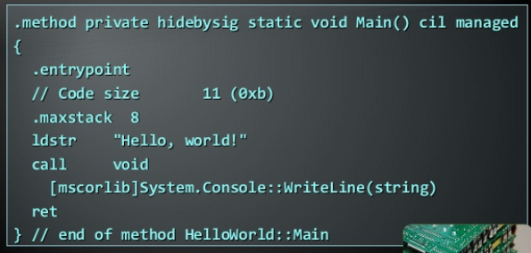
Sample MSIL Program

Slide 35
Compilation and Execution

Slide 36
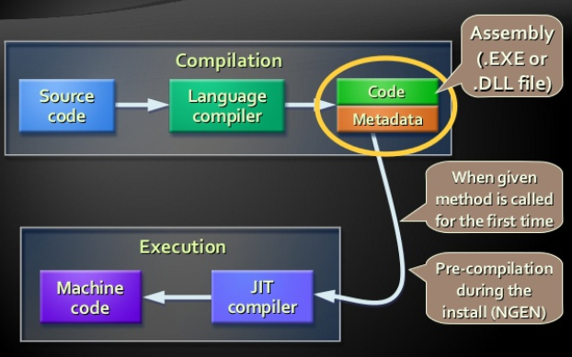
Compilation and Execution

Slide 37
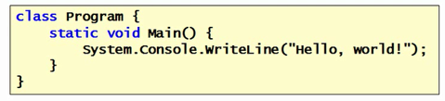
Getting Started
Each .Net program consists of a set of classes (types)
Some classes you write
Thousands of existing classes available in Framework Class Library (FCL) e.g. String, Stack, Socket…
A static entry point where things gets started
Called “Main” by default in C#

Slide 38
Just-In-Time (JIT Compilation)
Processor-specific code is generated at runtime
IL is verified to be typesafe
Accommodates evolution of types
Optimized for target machine not dev machine
Not interpreted
By default, on a method by method basis
Ngen.exe supports “pre-JIT”

Slide 39
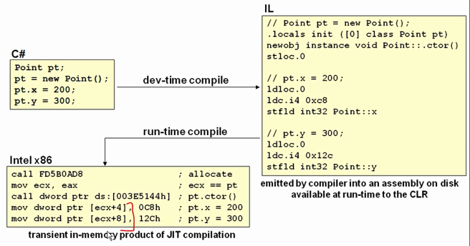
JIT Compilation

Slide 40
Assemblies
(Code packaging, loading and versioning)

Slide 41
.Net Assemblies
.Net Assemblies
Self containing .Net components stored in .dll or .exe files
Contains list of classes, types and resources
Smallest deployment unit in CLR
Have unique version number
.Net deployment model
No version conflicts (forget “DLL hell”)
Supports side-by-side execution of different versions of same assembly

Slide 42
Metadata in the Assemblies
Metadata in the .Net Assemblies
Data about the data contained in the assembly
Integral part of the assembly
Generated by .Net Language compiler
Describes all classes, their class members, version, resources etc…

Slide 43
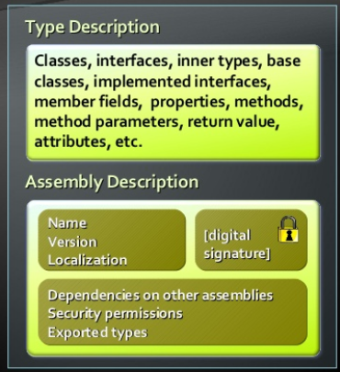
Metadata in Assemblies

Slide 44
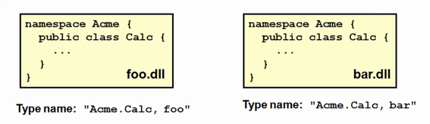
Assemblies & Types
Types are scoped by their containing assembly
Access control (public verses internal)
Type names are assembly-qualified
Same type-name in different assemblies = different types

Slide 45
Demo Assemblies

Slide 46
Demo Display Assembly info

Slide 47
Strong Names
Fully-specified assembly names have 4 parts
Friendly name
Version
Culture (language/region)
Key token (uniquely identifies publisher)
Involves public/private key technology

Slide 48

Key Files
SN.Exe creates/manages key files
-k command line option creates new key

Slide 49
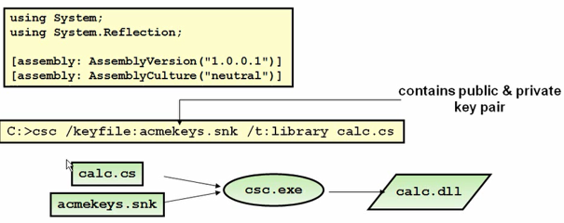
Strong Naming an Assembly
Assembly name is specified using attributes
or VS.Net project settings

Slide 50

Thank You!
Prashant Kulkarni
Technical Lead
Mobile: +91 9890913122
Desk: +91 20 66046341
Prashant.kulkarni@xoriant.com
www.xoriant.com
India
Mumbai
4th Floor, Nomura
Powai , Mumbai 400 076
Pune
5th Floor, Amar Paradigm
Baner, Pune 411 045
Kolkata
2B, 12th Floor, Tower ‘C’
Rajarhat, Kolkata 700 156
US – Corporate Headquarters
1248 Reamwood Avenue,
Sunnyvale, CA 94089
Phone: (408) 743 4400
343 Thornall St 720
Edison, NJ 08837
Phone: (732) 395 6900
UK
20 Broadwick Street
Soho, London
W1F 8HT, UK
89 Worship Street
Shoreditch,
London EC2A 2BF, UK
Phone: (44) 2079 938 955
Bangalore
4th Floor, Kabra Excelsior,
80 Feet Main Road, Koramangala 1st Block,
Bengaluru (Bangalore) 560034
Gurgaon
A/373rd Floor, Sigma Center
Gurgaon, Haryana 122 011s

